Slide 1
Assignment 4

Slide 2
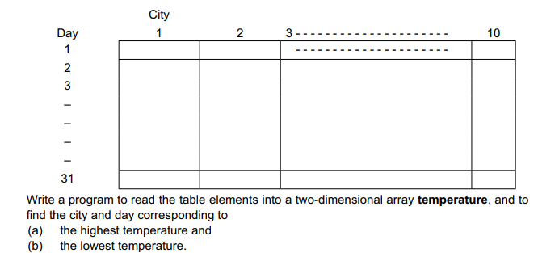

Slide 3


Slide 4
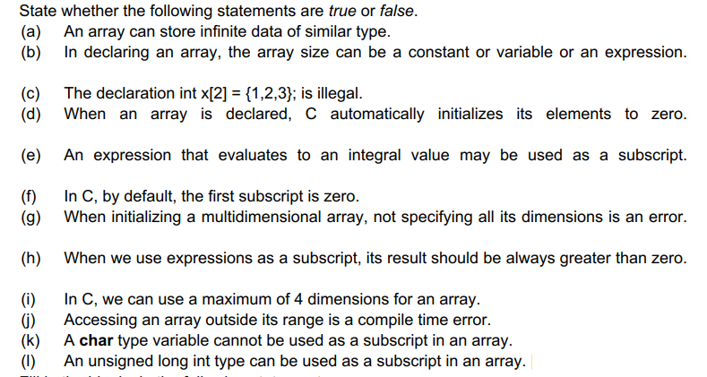

Slide 5
